Slide 1


A
Project Presentation
on
Name of Topic
Blockchain Based Tender Allocation System
By
Name and Roll No. of Students
Ankita Kashinath Kahandal | (6)
Pragati Prakash Bhor | (11)
Puja Arun Pawar | (42)
Roshani Arun Randhe | (44)
Name of Guide
(Mrs. Minakshi Gite )
Department of Information Technology
Matoshri College of Engineering & Research Centre, Nashik .
SAVITRIBAI PHULE PUNE UNIVERSITY 2024-2025

Slide 2
Blockchain Based Tender Allocation System

Slide 3
Content of this Project
Introduction
Problem Statement
Literature Review
Objectives
System Architecture and High level design of the project (DFD , UML).
Project Requirement specification
Techniques
Algorithms and Models Used
Methodology
Project Features
Advantages
Limitations
Conclusions
Future Scope
Working outputs
Project Plan
References

Slide 4

1. Introduction
Blockchain is a decentralized ledger ensuring transparency and immutability.
Traditional tender allocation is centralized and prone to corruption.
Blockchain introduces trustless, secure, and fair tendering.

Slide 5
Introduction
A Blockchain-based Tender Allocation System uses blockchain and smart contracts to make the tendering process transparent, secure, and tamper-proof.
This ensures transparency, prevents fraud or manipulation, and builds trust among all participants.
It removes middlemen, reduces corruption, and ensures fair and efficient selection of contractors through automated and verifiable transactions.

Slide 6

2. Problem Statement
Traditional government tendering systems are centralized, making them prone to:
  Data tampering and manipulation
  Bribery, favoritism, and corruption
Lack of transparency leads to mistrust among contractors and reduced participation.
Manual supervision in tender evaluation is time-consuming, costly, and error-prone.
Decisions are typically made based on the lowest bid price ,neglecting essential factors such as contractor reputation ,project quality and risk assessment .
There is a pressing need for a secure, transparent, and decentralized solution that can make tender allocation tamper-proof, fair, and efficient.

Slide 7
3. Literature Survey
Paper Published | Year | Description | Limitations | How Our Research is Better
Fair and Transparent Blockchain-based Tendering Framework. | 2018 | Proposes a smart-contract based tendering framework to make government tenders auditable using a Hyperledger Fabric . presents several blockchain-variant designs public and private. | No Privacy for sealed bids, not scalable ,and no clear user roles or identity system. | Our system uses a secure permissioned blockchain ,keeps bid private,improves speed and scalability with off chain ai work and clear roles for Admin,Contractor and auditor . .
AuditChain: A Trading Audit Platform Over Blockchain (Vishnia & Peters) | 2019 | Presents blockchain architecture for audit trails using ethereum like public chain used mainly for audit trails in financial trading system | Focuses only on Financial Systems ,Faces speed and delay ,and is not suitable for government tendering | Our system is specifically design for public procurement using a permissioned blockchain for faster performance and include ai based evaluation to handle tender related data efficiently

Slide 8
Literature Survey
Paper Published | Year | Description | Limitations | How Our Research is Better
A Blockchain-Based Sealed-Bid e-Auction Scheme with Smart Contract & ZK Proof | 2021 | Designs sealed-bid auctions using smart contracts and Zero-Knowledge Proofs (e.g., Bulletproofs) to ensure privacy and verifiability without exposing bids. | ZKP constructions are complex to implement take a lot of time to process,and cost more on the blockchain. | Our system uses a simpler permissioned blockchain for privacy and security ,and plans to add ZKProf in the future with optimized implementation, making it more scalable and cost effective for public tendors
Secure Framework for Government Tender Allocation using Blockchain. | 2022 | Shows a blockchain-based tender system that improves transparency and removes manual auction processes. | Small project with no proper roles ,weak admin security, and no smart way to compare bids | Our has clear roles ,strong security using a permissioned blockchain ,and ai based bid scoring for fair slection.
Government Tender Allocation Using Blockchain Technology. | 2023 | This study uses blockchain and smart contracts to make government tendering more transparent, secure, and efficient. | Complex Setup ,High computational cost ,limited security features ,no ai for bid scoring and scalability issues for large data | Our system uses a permissioned blockchain for faster and costr-efficient performance, adds ai based bid scoring and evaluation and data privacy support for handling large tender data.

Slide 9
4.Objective
Secure Smart Contract Design
  Design and develop a secure Solidity smart contract for the full tender lifecycle.
Transparent Ledger Establishment
  Establish an immutable ledger for all tenders, bids, and awards to ensure transparency. Transparent operations help reduce corruption.
User Role System Development
  Create a role-based system (Admin, Contractor, Auditor) to enforce policy controls. Distinct roles will enhance efficiency and control.
Web Interface Development
  Develop a user-friendly web interface (Frontend) for seamless blockchain interaction. Smooth user experince encourages participation.

Slide 10
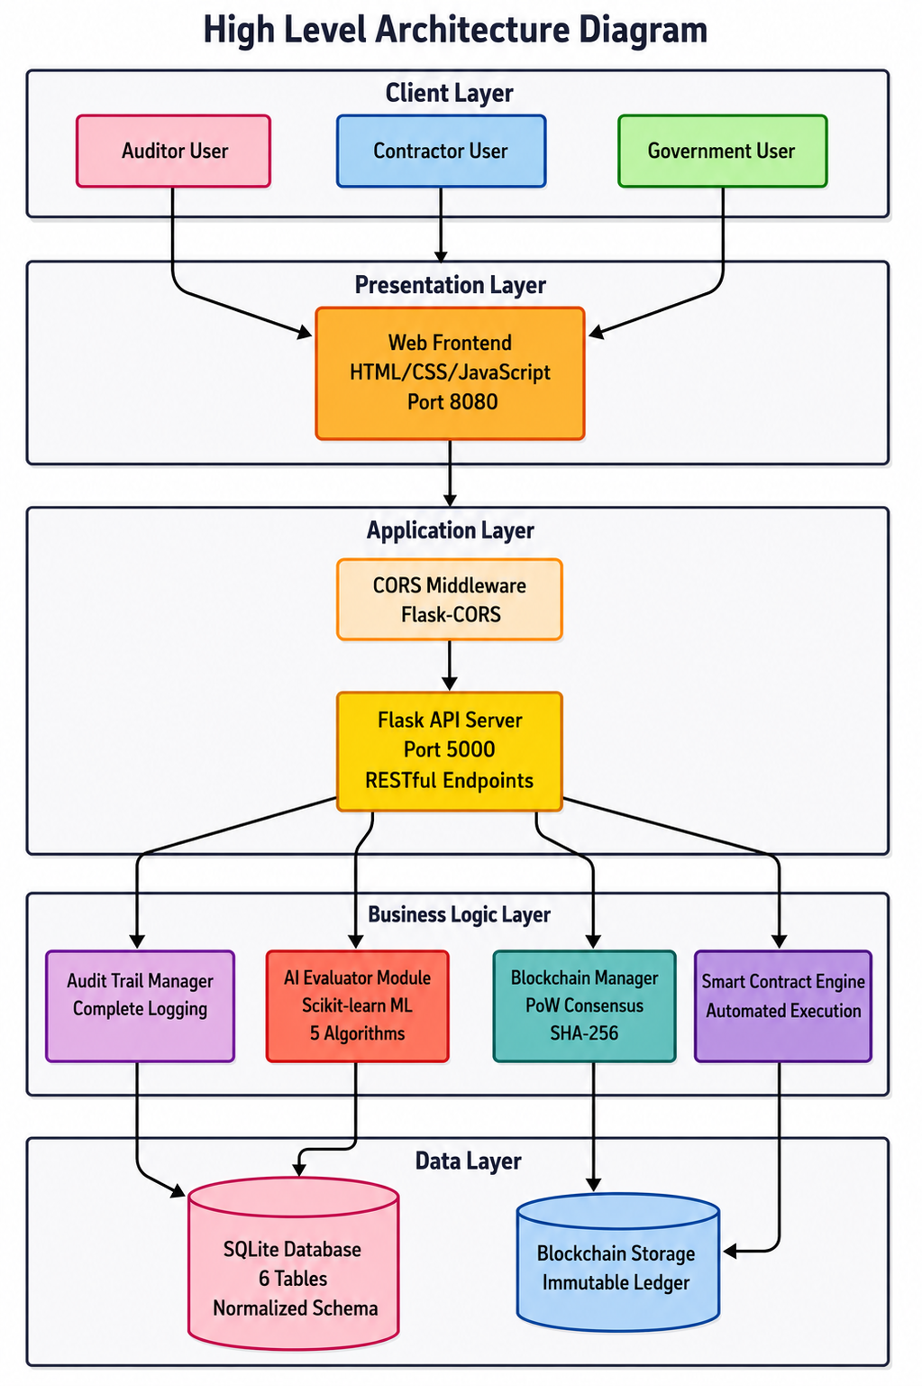
5. System Architecture

Slide 11
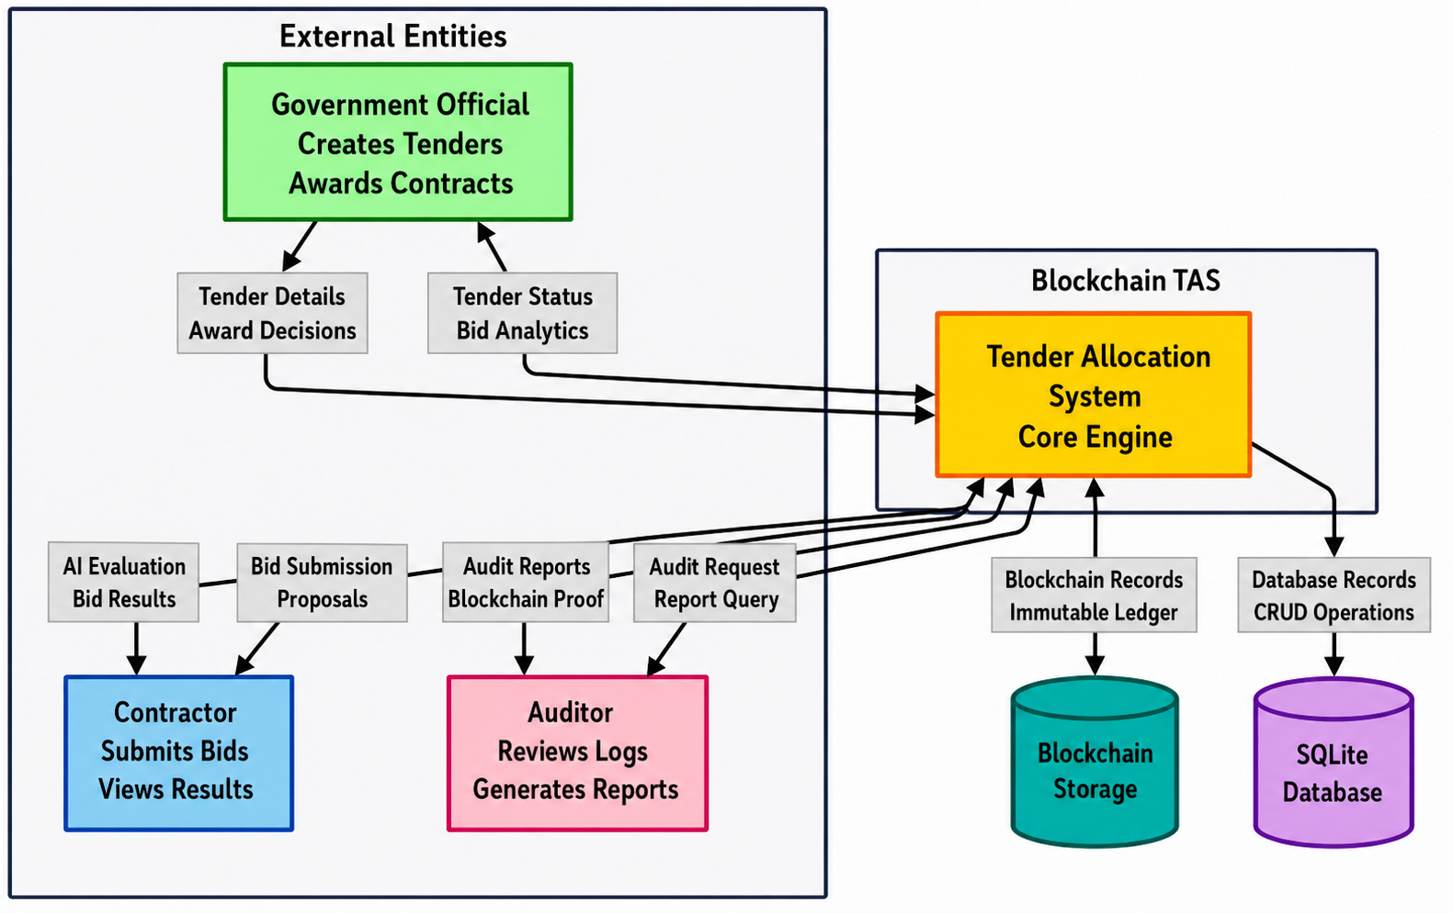
6. DFD Diagrams - Level 0

Slide 12
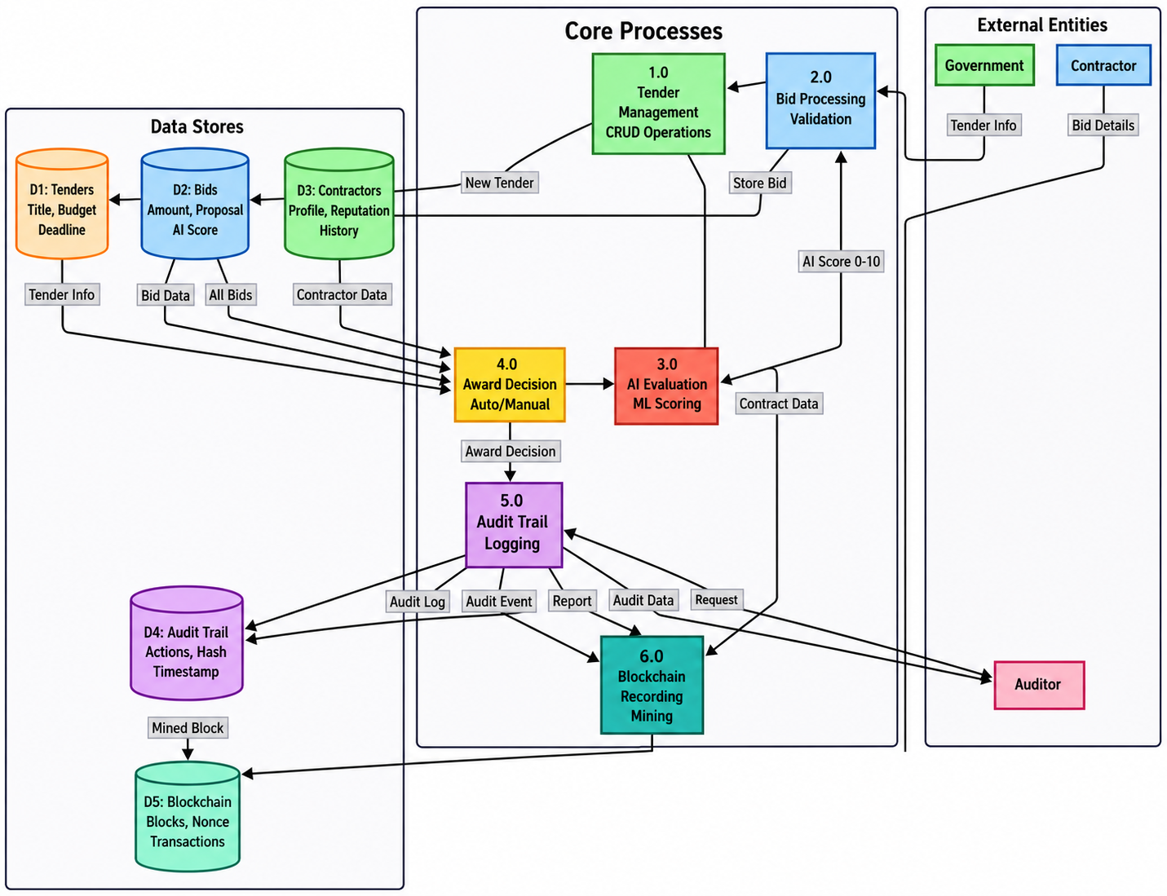
7. DFD Diagrams - Level 1

Slide 13
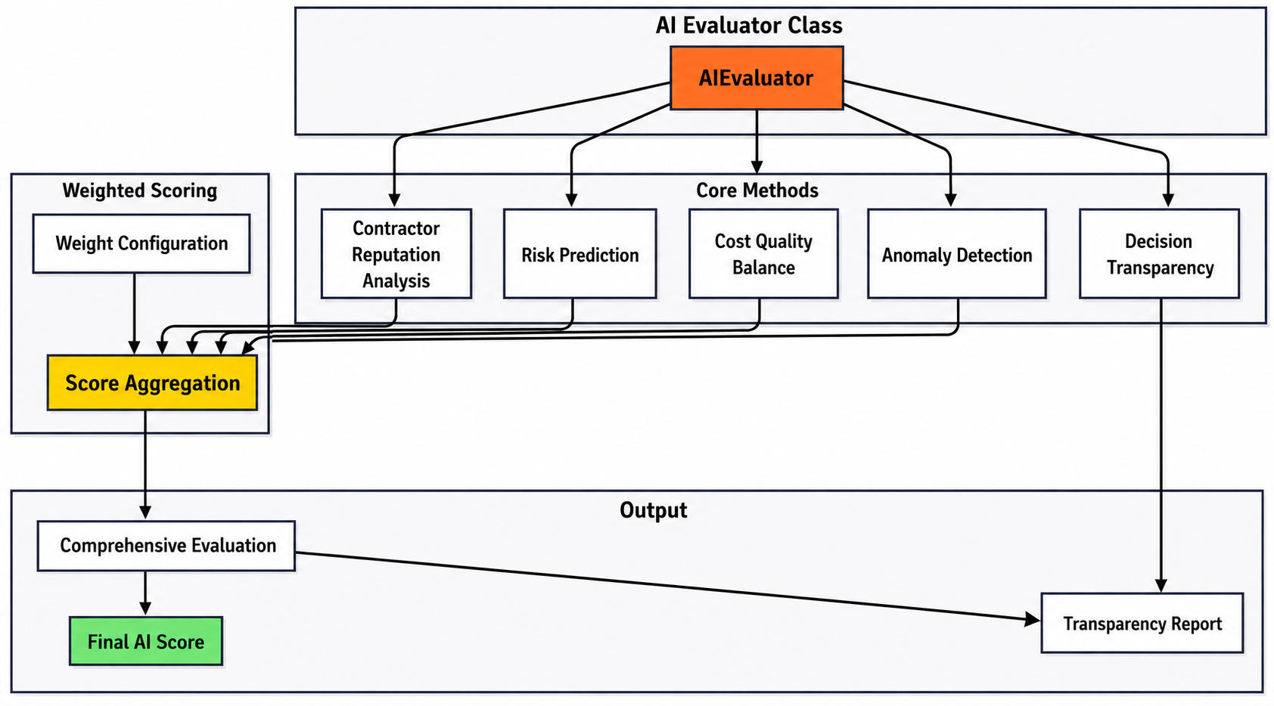
12.AI in Blockchain-Based Tender Allocation System

Slide 14
14. Project Requirement Specification:
Functional Requirements
  1. Authentication
  2. Contractor Registration
  3. Tender
  4. Bid Submission
  5. AI-Based Reputation
Non-Functional Requirements
1. Security
2. Transparency
3. Reliability
4. Scalability
Hardware Requirements
Processor: Intel Core i5
higherRAM: 8 GB
Storage: 256 GB SSD or higher
Software Requirements
Programming Languages: Python, JavaScript
Blockchain Platform: Ethereum
Smart Contract Language: Solidity
Database: SQLite
Frontend: HTML, CSS, JavaScript
User Requirements
Government Authority
Contractors
AI Engine

Slide 15
15. Techniques
Blockchain Technology
  Solidity for Contracts
  Solidity is used for smart contract development, ensuring secure and reliable contract execution. Secure contracts can be guaranteed with the use of Solidity.
  Ethereum Network
  Ethereum is a secure and reliable public blockchain for smart contract deployment. Ethereum creates a robust operational environment.
  Tools & Libraries
  Includes Hardhat, Ethers.js, and MetaMask for streamlined development and secure interactions. These tools help to manage the Ethereum blockchain.
Frontend Technologies
  HTML, CSS, and JavaScript
Backend Technologies
  Python and Flask are utilized for the server-side logic, API endpoints and management of the AI-scoring. These technologies create a robust server environment and functionality.

Slide 16
16. Algorithms and Models Used
1. Contractor Reputation Score Calculation
2. Contractor Risk Evaluation
3. Bid Anomaly Detection
4. Final AI Score Calculation

Slide 17
1. Contractor Reputation Score Calculation
5. Apply weights to each parameter:
Reputation = 30%
Experience = 30%
Completion = 25%
Rating = 15%
6. Calculate Total Score = Sum of all weighted values.
7. Scale the total score to a 0–10 range.
8. Output the final Reputation Score.
9. End
1.Start
2. Input contractor data.
3. Extract parameters:
Reputation Score
Number of Past Projects
Completion Rate
Average Rating
4. Normalize each parameter:
Reputation Score ÷ 10
Past Projects ÷ 20
Completion Rate ÷ 100
Average Rating ÷ 5

Slide 18
2. Contractor Risk Evaluation
1.Start
2. Input: Contractor Data and Bid Data.
3. Check if Tender Budget > 0
If No, set Price Risk = 0.1 and go to Step 10.
  If Yes, continue.
4. Calculate Price Ratio = Bid Amount / Budget
5. Determine Price Risk:
If Ratio < 0.7, then Price Risk = 0.3 (Suspiciously Low)
Else if Ratio > 1.2, then Price Risk = 0.2 (Over Budget)
Else Price Risk = 0.1 (Reasonable)
6. Calculate Experience Risk = max(0, (5 - Past Projects) × 0.1)
7. Calculate Completion Risk = max(0, (100 - Completion Rate) × 0.01)
8. Compute Total Risk = Experience Risk + Completion Risk + Price Risk
9. Cap the Total Risk at 1.0 (if it exceeds 1.0, set it to 1.0).
10. Classify Risk Level:
If Risk < 0.3, → Low Risk
Else if Risk < 0.6, → Medium Risk
Else → High Risk
11. Output: Risk Report showing Total Risk and Risk Level.
12. End

Slide 19
3. Bid Anomaly Detection
8. Calculate Z-Score:
z = |Current Bid − Mean| ÷ Std Dev
9. Check if z > 2.0:
If Yes, mark Is_Anomaly = TRUE
If No, mark Is_Anomaly = FALSE
10. If Is_Anomaly = FALSE, normalize the score:
Normalized Score = min(z ÷ 3.0, 1.0)
11. Compare Bid with Mean:
If Bid < Mean, → Type: Unusually Low
If Bid > Mean, → Type: Unusually High
Else → Type: Normal Range
12. Output: Anomaly Report
13. End
1.Start
2. Input: Current Bid and All Bids.
3. Check if there are sufficient bids (count ≥ 2):
If No, → Return: No Anomaly (Insufficient Data) and End.
4. Extract all bid amounts.
5. Calculate Mean = (Sum of all bids) ÷ (Number of bids).
6. Calculate Standard Deviation (Std Dev) =√(Sum of squared differences from mean ÷ n).
7. Check if Std Dev = 0:
If Yes, → Return: No Anomaly and End.

Slide 20
4. Final AI Score Calculation
1.Start
2. Input: Contractor Data, Bid Data, and All Bids.
3. Perform Reputation Analysis → Get Reputation Score.
4. Perform Cost-Quality Balance Analysis → Get Quality Score.
5. Perform Risk Prediction → Get Risk Score.
6. Convert Risk Score to Positive Value:
Positive Risk Score = (1 − Risk) × 10
7. Perform Anomaly Detection → Get Anomaly Score.
8. Calculate Anomaly Penalty = Anomaly Score × 2.
9. Apply Weights:
Reputation = 30%
Cost-Quality = 25%
Risk = 20%
10. Compute Weighted Sum = Sum of (Score × Weight).
11. Subtract Anomaly Penalty from Weighted Sum.
12. Clamp Final Score between 0 and 10
(if <0 → 0, if >10 → 10).
13. Round Final Score to 2 decimal places.
14. Output: Final AI Score.
15. End

Slide 21
17.Methodology
Tender Creation: Government (Admin) creates tenders via the frontend, which triggers a transaction on the smart contract. A government role improves the operational control.
Bid Submission: Approved contractors submit their bids; bid data is immutably recorded on the blockchain. Transparent transactions are integral to ensuring data integrity.
AI Analysis: After the bidding deadline, a backend service fetches bid data, and an AI engine scores it. The results are securely pushed back to the smart contract by the backend oracle.
Winner Selection: Admin selects the winner based on the AI-scored data, finalizing the award and creating an audit trail. Transparent workflow ensures data is not compromised.
Auditor Verification: The Auditor has read-only access to verify the entire process, ensuring unbiased operational oversight. The auditor role improves transparency.

Slide 22
18.Project Features
​
Blockchain-Based System → Ensures tamper-proof and transparent tendering process.
Smart Contracts → Automates tender creation, bid evaluation, and winner selection.
Commit–Reveal Bidding → Protects confidentiality of bids until reveal phase.
Decentralized Storage → Securely stores tender documents and attachments.
Scoring Algorithm → Evaluates bids using Time, Price, Environment, and Strength with time–strength dependency.
Role-Based Access Control → Separate permissions for government, contractors, and verifiers.
Auditability → Immutable record of all tenders and bids for public verification.
Security & Fairness → Eliminates favoritism, bribery, and bid manipulation.
User Interface → Easy access for contractors and authorities.

Slide 23
19. Advantages
Transparency → Every action is recorded on blockchain, visible to all stakeholders.
Security → Tamper-proof records prevent data manipulation and fraud.
Fairness → Commit–reveal bidding ensures equal opportunity for all contractors.
Decentralization → Removes single point of control, reducing corruption risks.
Efficiency → Smart contracts automate evaluation and winner selection, saving time and cost.
Trust Building → Increases confidence among contractors and government agencies.

Slide 24
20.What is Ethereum ?
Ethereum is used because it acts like the base system (the internet) for running smart contracts and decentralized apps.
It allows our application to store tender data safely, make bidding transparent, and stop anyone from changing or deleting information.
You connect to Ethereum through a node (like using an internet provider such as Jio or Airtel). The node helps your app read and write data on the blockchain — for example, checking bids, adding new bids, or selecting winners.

Slide 25
21. Future Scope
Enhanced Verification:Implementing digital passports for contractors enhances verification during the bidding process. Decentralized Identity ensures trust.
Confidential Bids:Submit confidential bid data privately through ZK-Proofs, enhancing the safety of sensitive financial bids.
AI Predictions
AI predicts real costs and timelines before choosing a winner.
Flags bids that seem cheap but may have hidden costs or delays.
Smart Contracts + IoT
Connects to on-site sensors.
Automatically releases payment when a milestone is completed.
No paperwork, no delays.

Slide 26
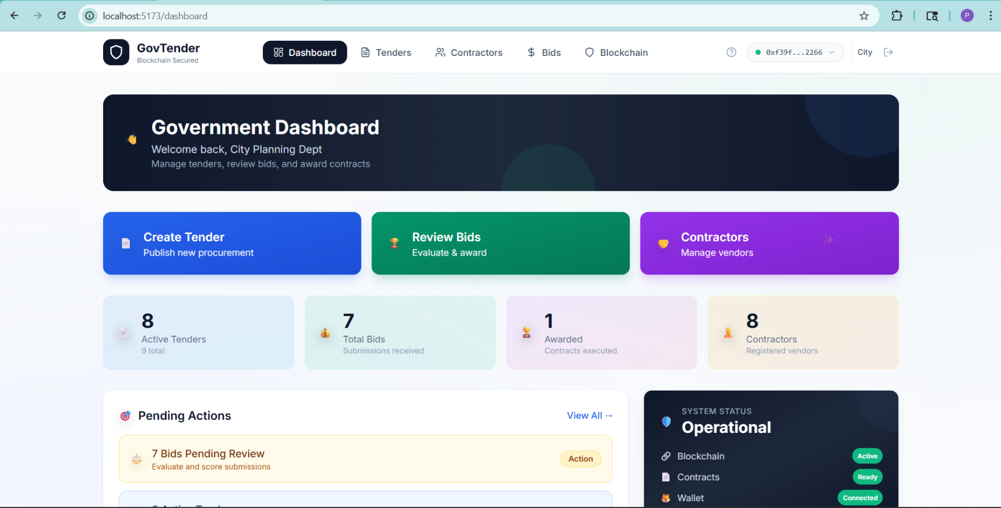
26. Working Outputs

Slide 27
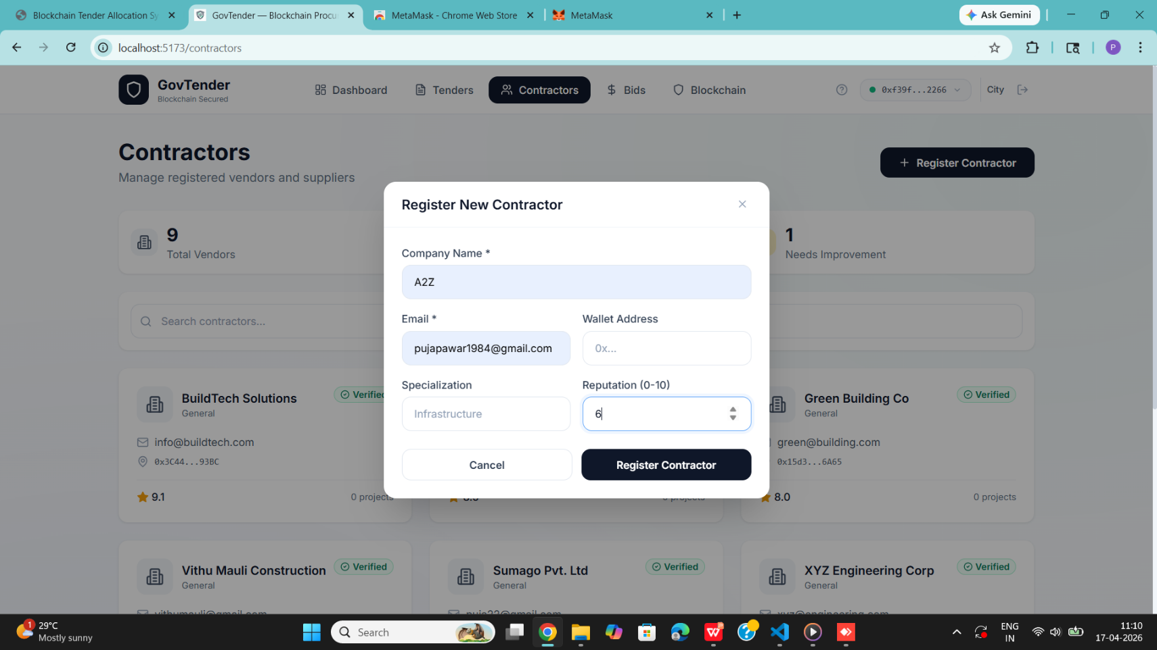
Output

Slide 28
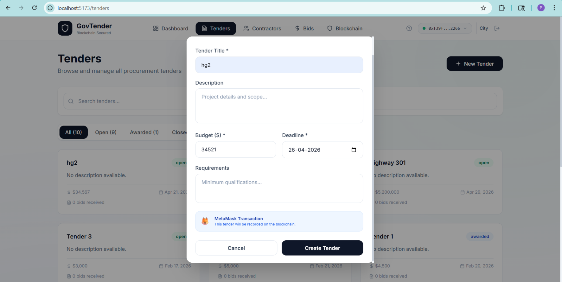
Output

Slide 29
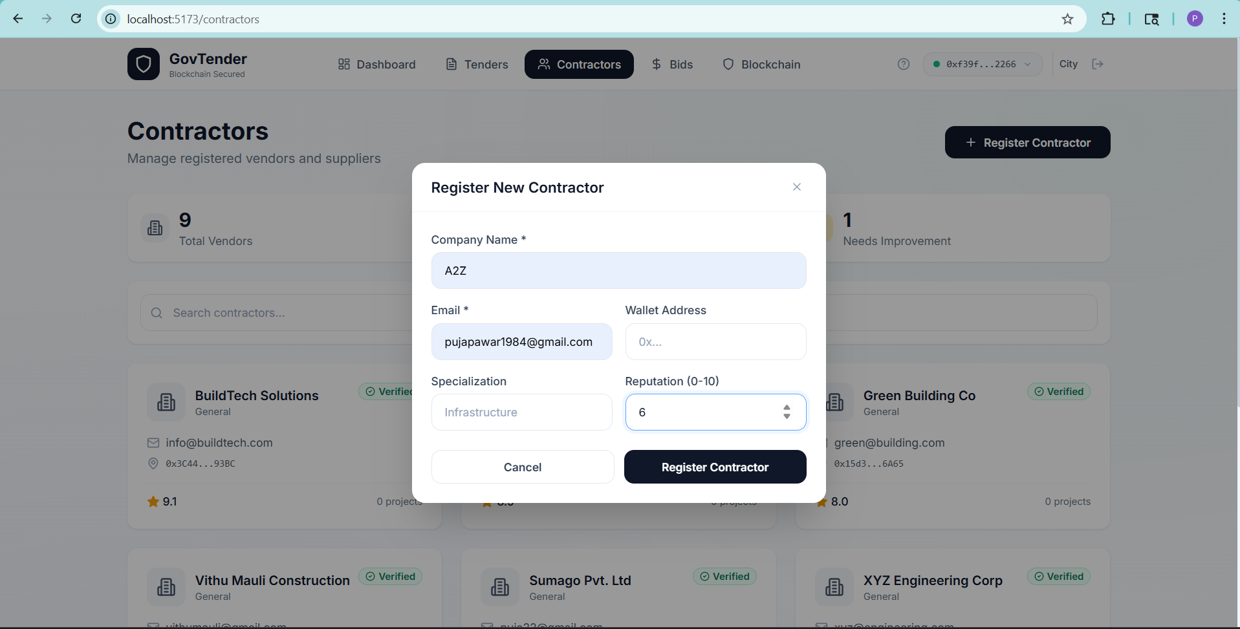
Output

Slide 30
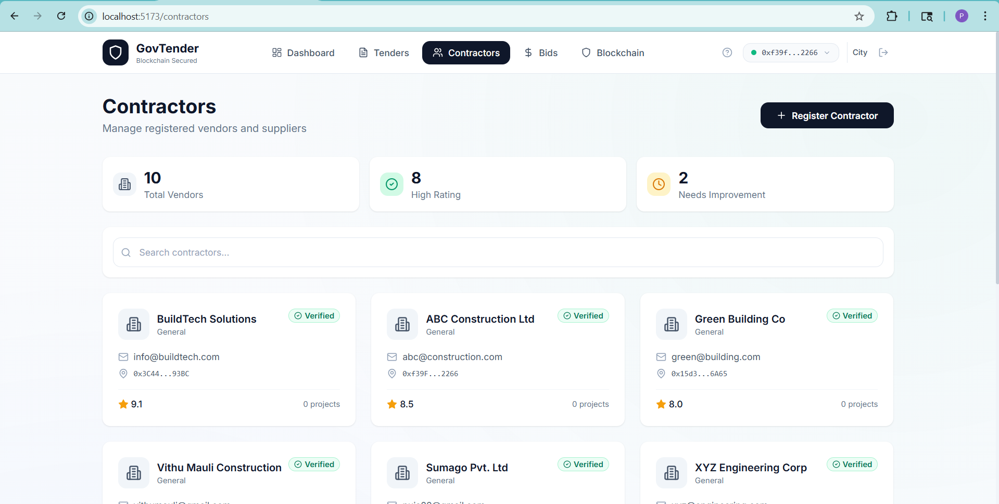
Output

Slide 31
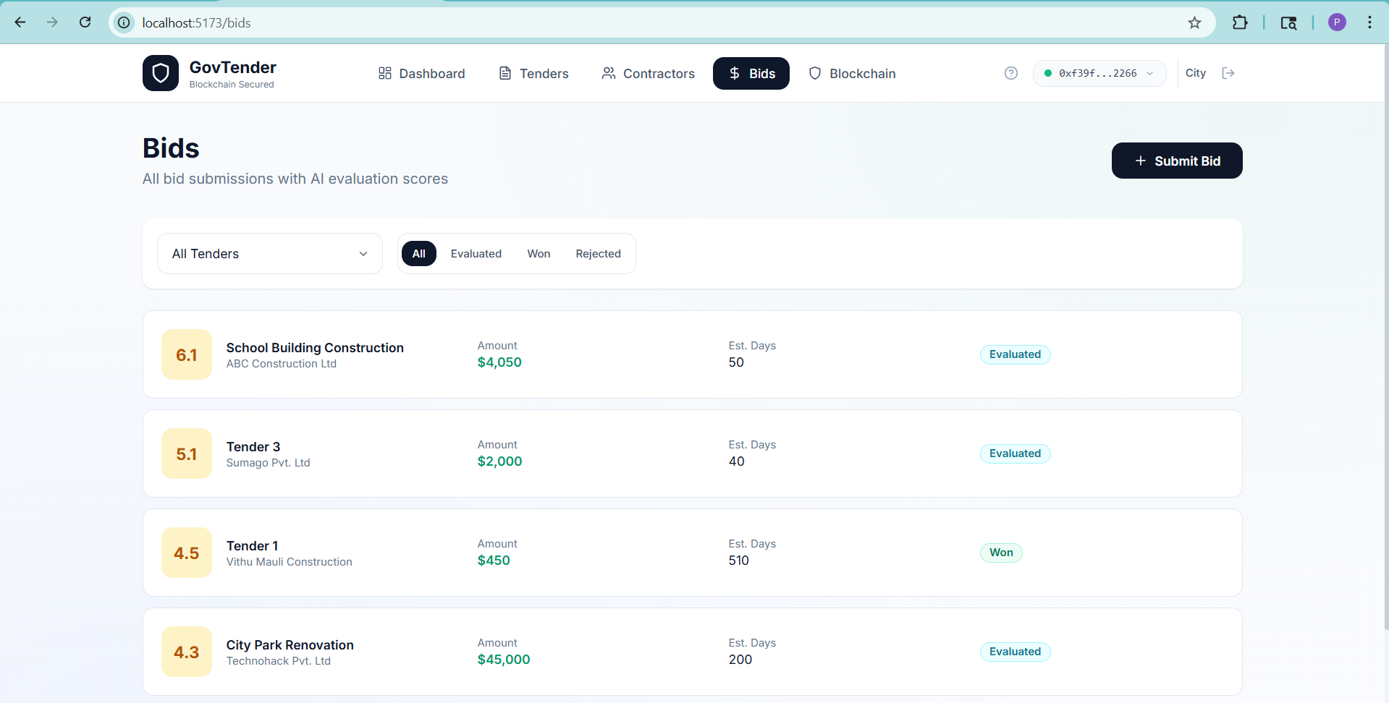
Output

Slide 32
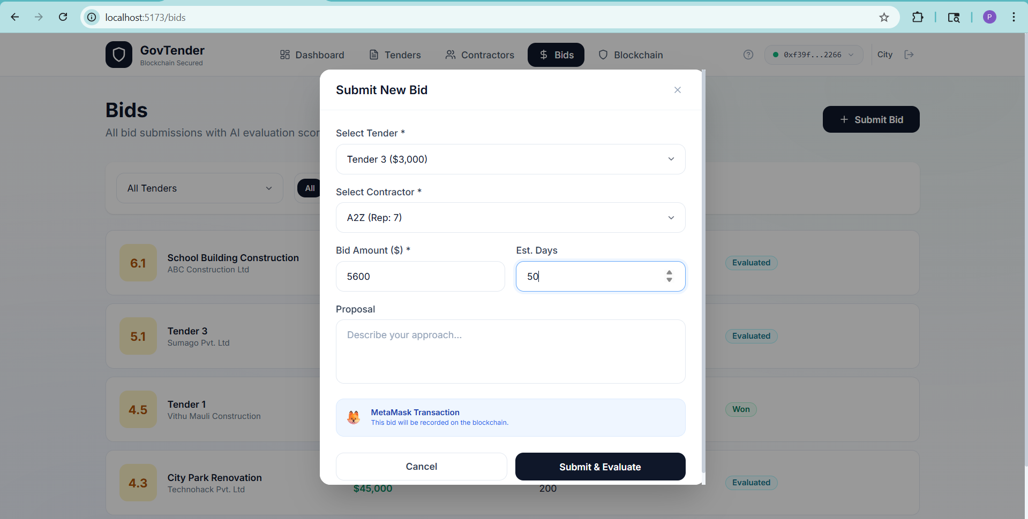
Output

Slide 33
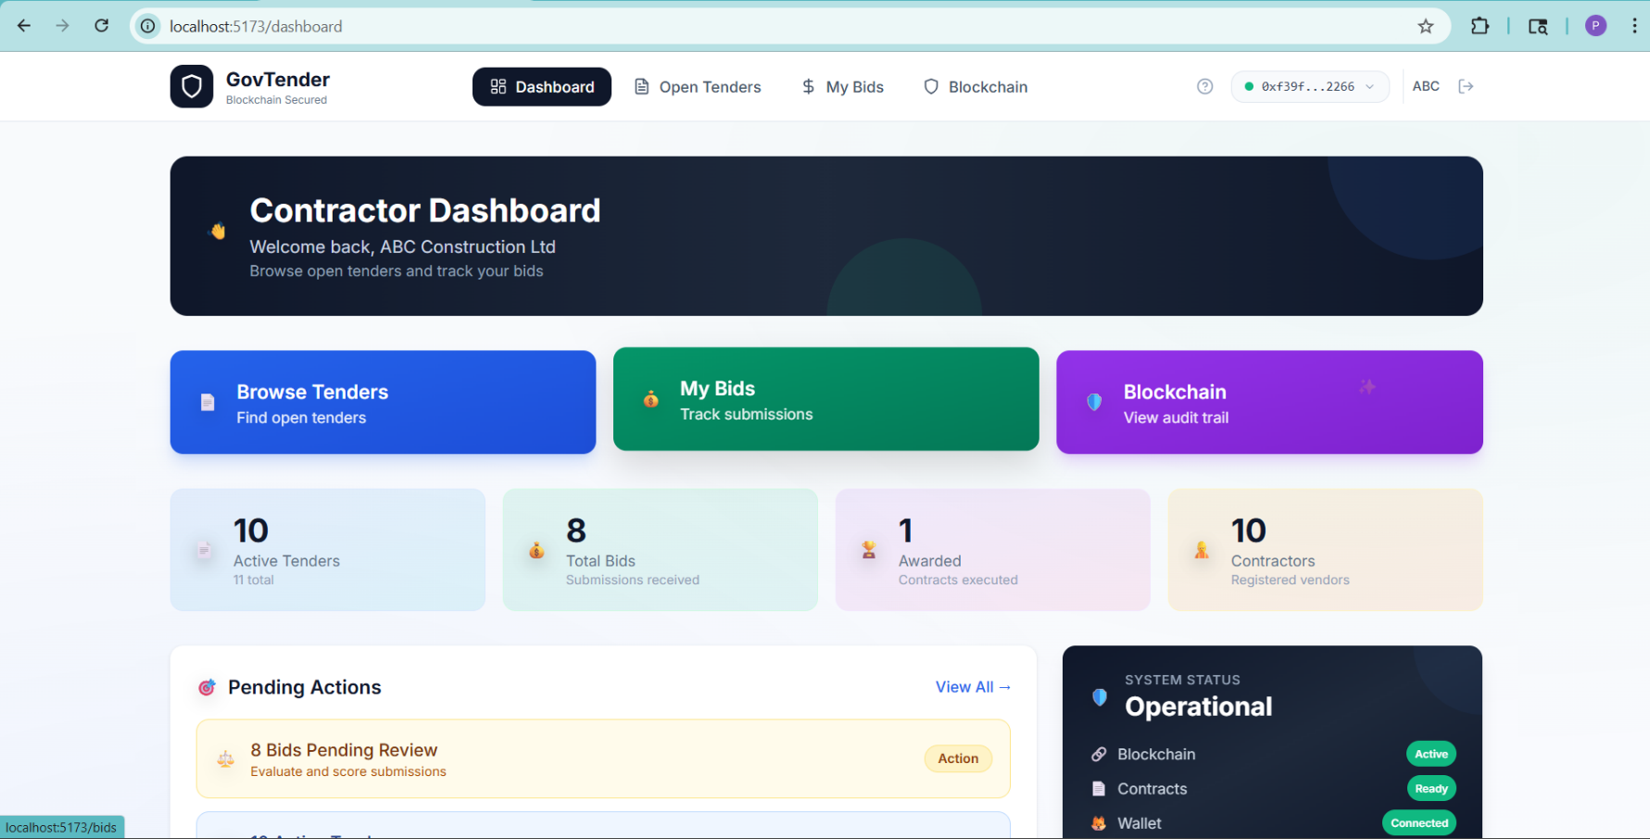
Output

Slide 34
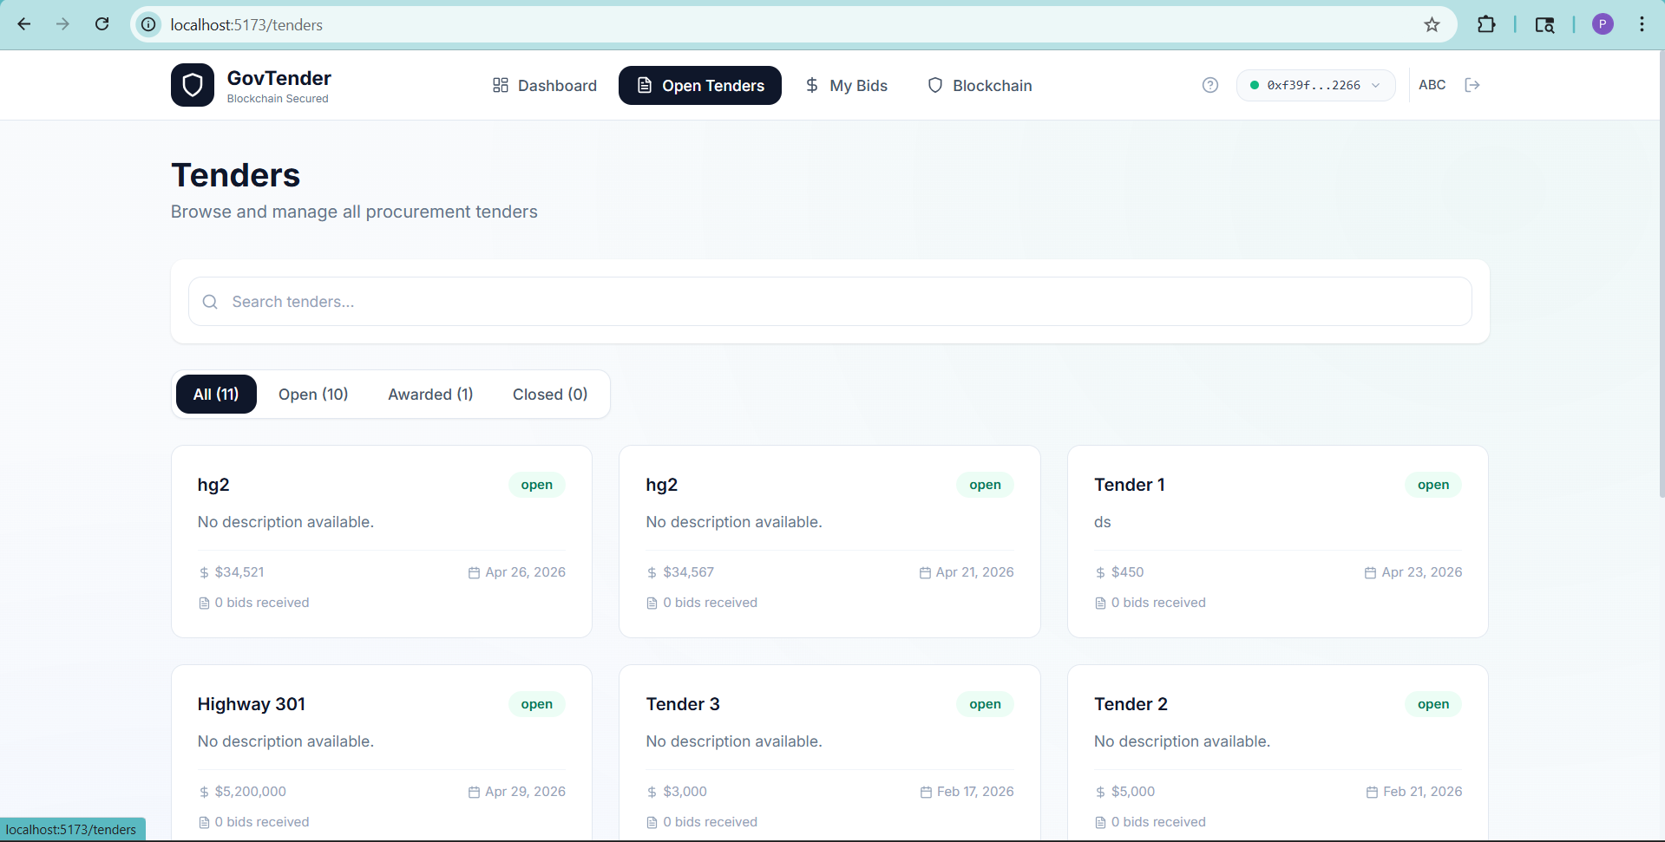
Output

Slide 35
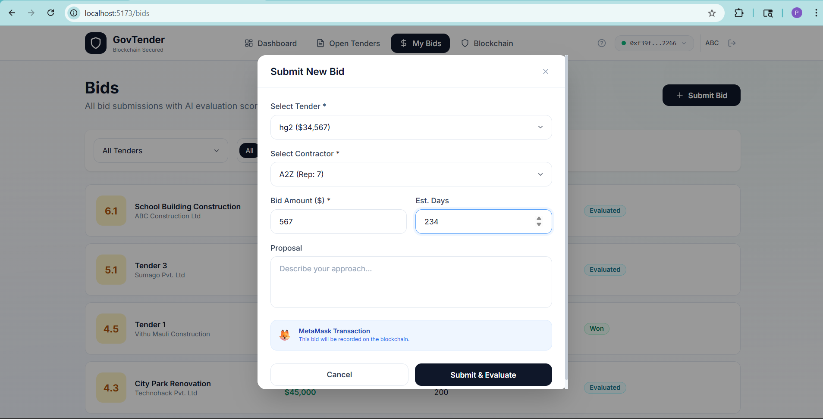
Output

Slide 36
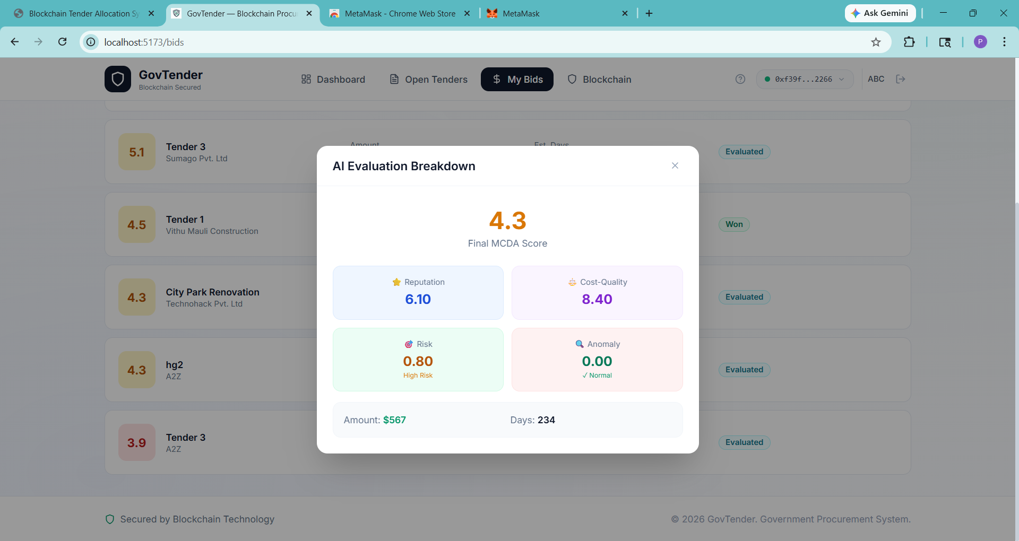
Output

Slide 37
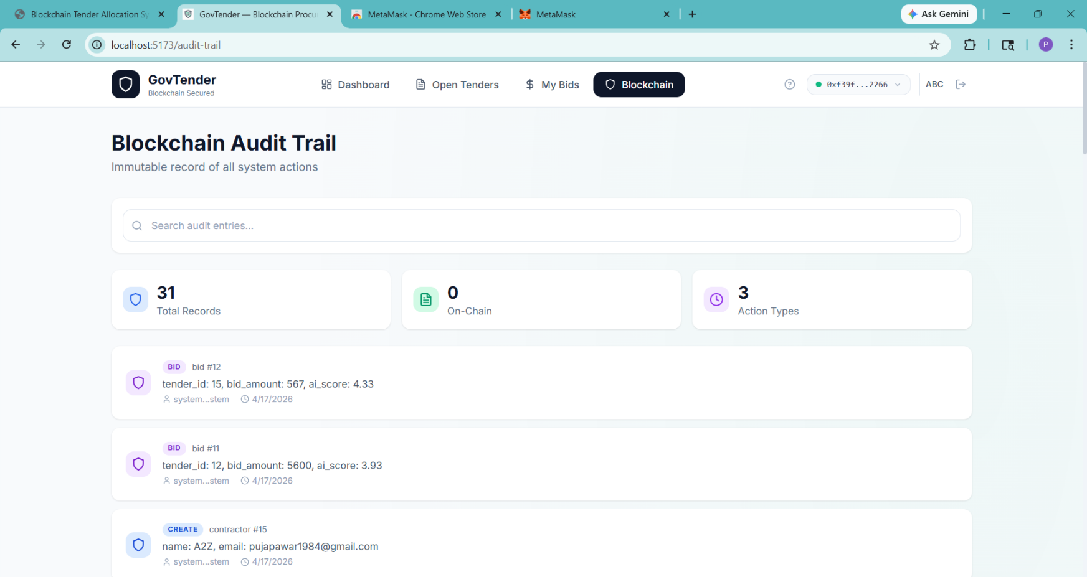
Output

Slide 38
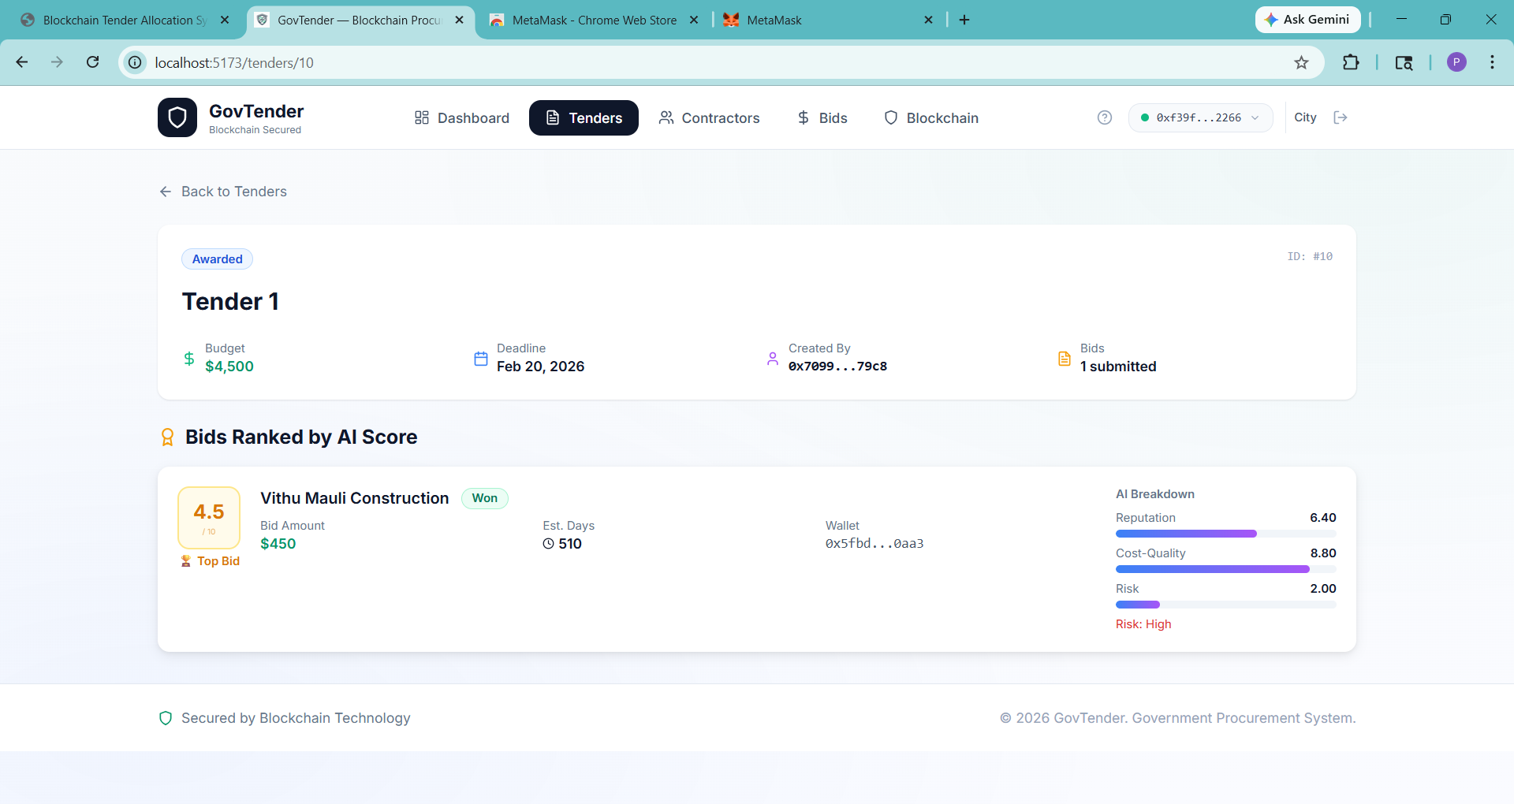
Output

Slide 39
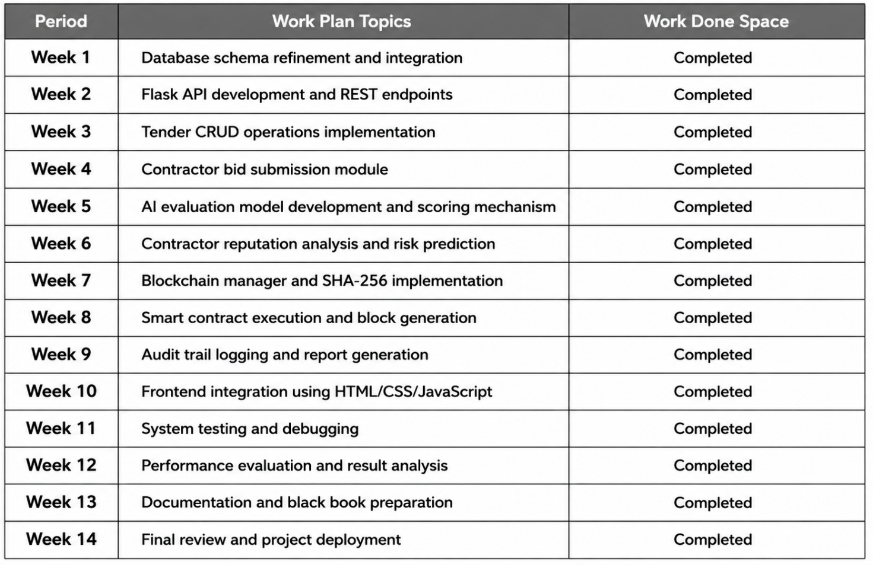
27.Project Plan

Slide 40
28.References
Hardwick, F.S., Akram, R.N., & Markantonakis, K., “Fair and Transparent Blockchain-Based Tendering Framework,” IEEE, 2018.
Vishnia, R., & Peters, G., “AuditChain: A Trading Audit Platform Over Blockchain,” Frontiers in Blockchain, 2020.
Mali, D., Mogaveera, D., Kitawat, P., & Jawwad, M., “Blockchain-based e-Tendering System,” 4th ICICCS, IEEE, 2020.
Li, L., Liu, J., & Jia, P., “SecTEP: Enabling Secure Tender Evaluation with Sealed Prices and Quality Evaluation in Procurement Bidding Systems over Blockchain,” Computers & Security, Vol. 103, 2021.
More, R., Kadam, P., Phadtare, T., Bhagat, K., & Wagh, C.S., “Secure Framework for Government Tender Allocation Using Blockchain,” IJARSCT, Vol. 2, Issue 1, 2022.
Dubey, S., Singh, P., Verma, R.K., & Kamboj, D., “Government Tender Allocation Using Blockchain Technology,” IEEE ICICAT, 2023.

Slide 41


